Slide 1
TCP/IP Fundamentals

Slide 2
TCP/IP architecture
A set of protocols allowing communication across diverse networks
Out of ARPANET
Emphasize on robustness regarding to failure
Emphasize on Flexibility in operating on diverse networks
As a result, TCP/IP architecture

Slide 3
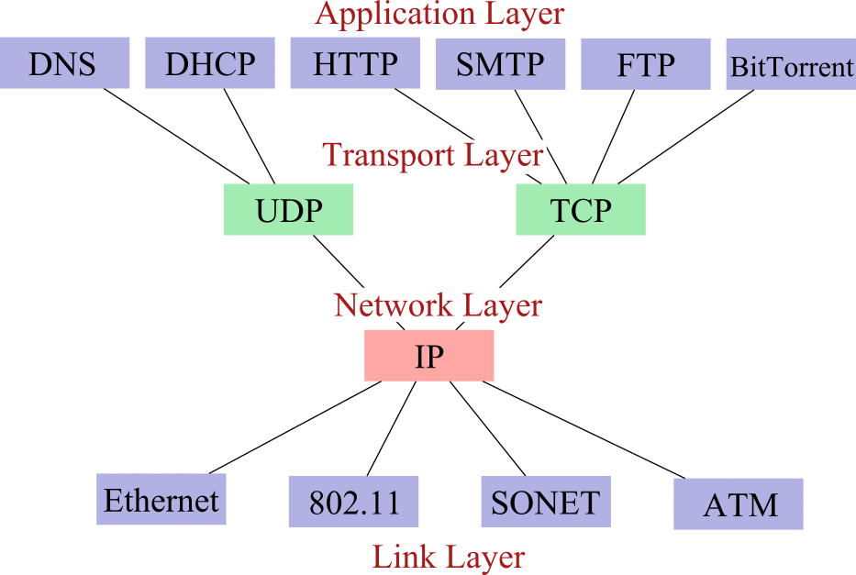
The Internet Hourglass
ICMP, ARP & RARP
802.3

Slide 4
TCP/IP network architecture
Application
Layer
Application
Layer
Transport
Layer
Transport
Layer
Internet
Layer
Internet
Layer
Network
Interface
Network
Interface
Physical
Physical
(a)
(b)
TCP/IP model does not
require strict layering
Figure 2.10

Slide 5
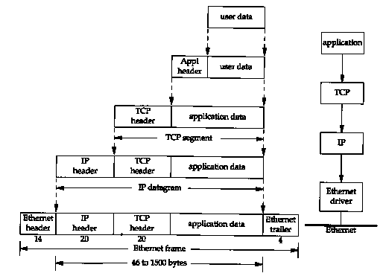
Encapsulation

Slide 6
TCP/IP architecture—application layer
Provide services that can be used by other applications
Incorporate the functions of top 3 OSI layers
E.g., HTTP protocol, format in request, dialogue between client and server
http request/response contains format information, so transformation.
a web page may contain text, graphics, Macromedia Flash objects and perhaps a Java applet . Different files, different downloads, the browser keeps tracks of downloads.

Slide 7
TCP/IP architecture—transport layer
Application layer directly run over the transport layer, corresponding to OSI transport layer.
Two kinds of services: TCP & UDP.
TCP—Transmission Control Protocol, reliable connect-oriented transfer of a byte stream.
UDP—User Datagram Protocol, best-effort connectionless transfer of individual messages.

Slide 8
TCP/IP architecture-- Internet layer
Machine A
Machine B
Application
Application
Router/Gateway
Transport
Transport
Internet
Internet
Internet
Network Interface
Network Interface
Network Interface
Network 1
Network 2
Transfer of information across networks through gateways/routers
Corresponding to OSI network layer: routing and congestion control
Global unique IP address and IP packets
Best-effort connectionless IP packet transfer: no setup, routed independently, robust, out of order, duplicate, or lose of packet
Figure 2.11

Slide 9
TCP/IP architecture-- Network interface layer
Machine A
Machine B
Application
Application
Router/Gateway
Transport
Transport
IP
packet
IP
packet
Internet
IP
packet
IP
packet
Internet
Internet
Network InterfaceS
Network Interface
Network Interface
Packet
of network1
Packet
of network2
Packet
of network1
Packet
of network2
Network 1
Network 2
Concerned with network-specific aspects of the transfer of packets
Corresponding to part of OSI network layer and data link layer
Different network interfaces: X.25, ATM, frame relay, Ethernet, etc
1. Router receives a frame from one network (e.g., N1) through its physical layer
2. The data link entity for N1 extracts the IP packet from the frame and passes the IP packet up to its network entity.
3. The network entity checks destination IP address (finds the packet is not for itself) and determines the next hop based on destination IP address (i.e., routing) , this next hop router will be in another network (e.g. N2)
4. Network entity passes the IP packet down to the data link entity for N2
5. Data link entity for N2 encapsulates the IP packet in a frame of N2 and passes the frame down to physical layer for transmission to the next router through network N2.
Figure 2.11

Slide 10
The procedure executed at routers
1. Router receives a frame from one network (e.g., N1) through its physical layer
2. The data link entity for N1 extracts the IP packet from the frame and passes the IP packet up to its network entity.
3. The network entity checks destination IP address (finds the packet is not for itself) and determines the next hop based on destination IP address (i.e., routing) , this next hop router will be in another network (e.g. N2)
4. Network entity passes the IP packet down to the data link entity for N2
5. Data link entity for N2 encapsulates the IP packet in a frame of N2 and passes the frame down to physical layer for transmission to the next router through network N2.

Slide 11
App.
HTTP
SMTP
DNS
RTP
Transport
TCP
UDP
TCP/UDP Provides
a network
independent
platform
IP provides
independence
from underlying
networks
Internet
IP
Network Interface 1
Network Interface 2
Network Interface 3
(e.g., Ethernet driver)
(e.g., PPP driver)
TCP/IP protocol graph
Figure 2.12

Slide 12
TCP/IP big picture: how the layers work together
Examples of each of the layers
How the layers interact across the interfaces
How PDUs of a layer are built and what key information is in the header
Relationship between physical address and IP address
How an IP packet is routed across several networks

Slide 13
An internet consisting of an Ethernet LAN and a point-to-point link
(a)
(1,1)
(2,1)
router
(2,2)
s
(1,3) r
PPP
Ethernet
w
(1,2)
(b)
Server
HTTP etc.
PC
HTTP etc.
TCP/UDP
Router
TCP/UDP
IP
IP
IP
Net Interface
Net Interfaces
Net Interface
Ethernet
PPP
Figure 2.13

Slide 14
(1,1)
(2,1)
router
(2,2)
s
(1,3) r
PPP
Ethernet
w
(1,2)
PPP is also a specific network
IP address: network ID + host ID, such as (1,1),(2,2)…
Physical address (such as s, r,…):
For Ethernet, each machine in an Ethernet has an NIC
card with a global unique flat 48-bit address
For PPP, no need for physical address
Router has two IP addresses: (1,3), (2,1)
Figure 2.13

Slide 15
Example 1:Workstation sends an IP datagram to the server
(a)
(1,1)
(2,1)
router
(2,2)
s
(1,3) r
PPP
w
0. Assumed server’s IP is known to workstation, if not,…
1.Workstation (IP entity) finds server’s physical address
2.IP entity forms and passes IP packet down to
Ethernet driver along with physical addresses w, s
3. Ethernet driver forms Ethernet frame and broadcast
4. Server NIC captures the frame due to its address s
5. Find it is an IP so pass up to IP entity
Ethernet
(1,2)
(b)
Workstation
HTTP etc.
HTTP etc.
Server
TCP/UDP
TCP/UDP
IP
IP
(1,2)(1,1) data
(1,2)(1,1) data
Ethernet driver
Ethernet driver
w,s, IP (1,2)(1.1) data
w,s, IP (1,2)(1.1) data
Ethernet
Figure 2.13

Slide 16
Example1—Workstation sends a IP datagram to the server (cont.)
How does workstation know the server’s IP address?
First search in its cache, if not found, query by DNS and cache it
IP entity in workstation knows that the server is in
the same network, why?
Because of the same network ID
How to know the server’s physical address ?
looks up its mapping table to try to find server’s physical
address s. if server’s physical address is not known,
by ARP (Address Resolution Protocol) to find it.

Slide 17
Example 2: server sends a IP datagram to PC
(a)
(1,1)
(2,1)
router
(2,2)
s
(1,3) r
PPP
Ethernet
w
1. Server forms IP packet with PC as destination
2. Server sends packet to router first by broadcast
3. Router finds the packet is not for itself, so sends to PC
4. PC finds the IP packet is for it,so pass on to upper layer
(1) IP packet is the same all the way, but frames are not
(2) Addresses in frame is different from ones in IP packet
(2) Router has two network interfaces
(1,2)
(b)
Server
HTTP etc.
PC
HTTP etc.
TCP/UDP
Router
TCP/UDP
IP
IP
IP
(1,1)(2,2) data
(1,1)(2,2) data
(1,1)(2,2) data
Net Interface
Net InterfaceS
Net Interface
s,r,IP (1,1)(2,2) data
r,pc,IP (1,1)(2,2) data
Ethernet
PPP
Figure 2.13

Slide 18
Example2: server sends IP datagram to PC (cont.)
How to routing, i e., why server knows to send the IP packet to the router first ?
Look up routing table, in detail,
by complete destination IP address, if not found
by network ID of destination IP address, if not found
the default router is selected. (In this example, we assume the router r is the default router).
For a PPP frame, there is no need for physical address in the other end.
The IP address of a home computer connected to the Internet through modem is dynamically assigned (DHCP) .

Slide 19
Header contains source and
destination IP addresses;
Upper level (i.e. transport)
protocol type
IP
Header
Header contains source and destination physical addresses;
Upper level (i.e. network) protocol type
Ethernet Header
Frame Check Sequence
IP datagram is encapsulated in an Ethernet frame
Figure 2.14

Slide 20
S sends a packet to R:
Find R’s IP address by DNS.
Check its routing table for R, if find (next hop), send to it.
Otherwise, send to default router
Needs to find the physical address of the next hop router.
The router checks its routing table for the next hop and send to it.
s
net 3
G
net 1
G
G
G
net 5
net 2
G
net 4
G
R
6. continue until the packet reaches the router in the same LAN with R.
7. The router finds R’s physical address and sends to it.
Figure 2.8

Slide 21
Big picture: web document browsing
Suppose a user on PC clicks a link of a document contained in the server, and HTTP client passes a request to TCP layer asking for setting up a TCP connection, and the TCP connection between the PC and the server has been established (How? Discuss later).
The http client then passes http request message (such as GET /….) to TCP layer, what will happen??

Slide 22
Big picture: web document browsing—HTTP request is passed down
HTTP Request
c, 80
Header contains source and destination port numbers
TCP Header
(2,2)(11),TCP
Header contains source and destination IP addresses; transport protocol type
IP Header
pc,r,IP
Header contains source and destination physical addresses; network protocol type
Frame Check Sequence
ppp Header
Figure 2.15

Slide 23
Big picture: web document browsing
The ppp driver (data link entity) in PC forms a PPP frame and sends the frame to the other end of the PPP link, i.e., router
The router extracts IP packet (from the PPP frame), makes routing decision according on destination IP address (1,1), forms an Ethernet frame (encapsulating the IP packet) and broadcasts it onto Ethernet
The server NIC captures the frame, extracts the IP packet and passes it to IP entity, then to TCP entity and then to HTTP server
Finally the server retrieves the document and puts it in HTTP response packet and sends back to PC.

Slide 24
Sever processes multiple requests
Question: there is one http server, there may be several http clients which sends http requests to the http server simultaneously,so there are several connections at the same with the same destination IP address, same port number: 80, and the same protocol type: TCP. How does the server distinguish these connections and process them separately?
http client
http client
http server
http client
http client

Slide 25
Sever processes multiple requests
Answer: the way to specify the end-to-end process-to-process connection.
Socket address: port number + IP address + protocol type
Sender socket address: sender port number + sender IP address + protocol type
Receiver socket address: receiver port number + receiver IP address + protocol type.
Connection = sender socket address + receiver socket address
http client
http client
http server
m2
c2,m1; s, 80, TCP
m1
http client
http client
cc,m3; s, 80,TCP
m3
c1,m1, s, 80, TCP

Slide 26
Berkeley socket interface
The most popular interface to access network resources
Write applications without worry about underlying networking detail
Connection-oriented service (TCP connection and transfer) and connectionless service (UDP datagram delivery)
Socket is physically a handle on which other functions can be called and finish access tasks.

Slide 27
Communication through socket interface
socket interface
Application 1
Application 2
socket interface
user
user
kernel
kernel
Socket
Socket
Underlying communication Protocols
Underlying communication Protocols
Communications network
Figure 2.16

Slide 28
Server
socket()
bind()
listen()
Client
accept()
socket()
blocks until server receives
a connect request from client
connect negotiation
connect()
read()
data
write()
write()
data
read()
close()
close()
Socket calls for connection-oriented communication
Figure 2.17

Slide 29
Server
socket()
Client
socket()
bind()
bind()
recvfrom()
blocks until server
sendto()
receives data from client
data
sendto()
data
recvfrom()
close()
close()
Socket calls for connectionless communication
Figure 2.18

Slide 30
Application protocols and TCP/IP utilities
telnet: remote login. Also a tool to test other protocols.
FTP: File Transfer Protocols.
Ping: determine whether a host is reachable
Traceroute: determine the route that a packet will take to another host
Netstate: provide information about the network status of a local host
TCPdump: capture and observe packet exchange in a link.

Slide 31
TCP Connection Creation
Programming details later - for now we are concerned with the actual communication.
A server accepts a connection.
Must be looking for new connections!
A client requests a connection.
Must know where the server is!

Slide 32
Client
Server
SYN
ISN=X
1
SYN
ISN=Y ACK=X+1
time
2
ACK=Y+1
3

Slide 33
TCP TIME_WAIT
Once a TCP connection has been terminated (the last ACK sent) there is some unfinished business:
What if the ACK is lost? The last FIN will be resent and it must be ACK’d.
What if there are lost or duplicated segments that finally reach the destination after a long delay?
TCP hangs out for a while to handle these situations.

Slide 34
Termination
The TCP layer can send a RST segment that terminates a connection if something is wrong.
Usually the application tells TCP to terminate the connection politely with a FIN segment.

Slide 35
Test Questions
Why is a 3-way handshake necessary?
HINTS: TCP is a reliable service, IP delivers each TCP segment, IP is not reliable.
Who sends the first FIN - the server or the client?
Once the connection is established, what is the difference between the operation of the server’s TCP layer and the client’s TCP layer?
What happens if a bad guy can guess ISNs?

Slide 36
App1
App2
FIN
SN=X
1
ACK=X+1
2
...
FIN
SN=Y
3
ACK=Y+1
4

Slide 37
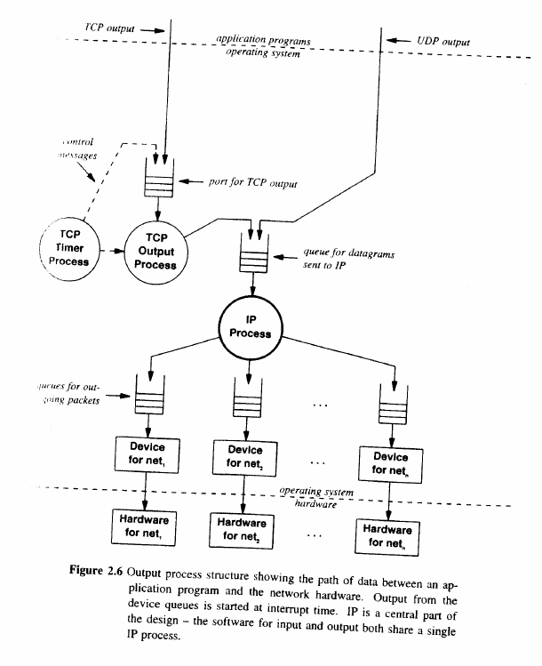

Slide 38
